Slide 1
Android Life Cycle

Slide 2
Managing the Activity Lifecycle
As user navigates through, out of, and back to app, the Activity instances in the app transition between different states in their lifecycle
For instance, when an activity starts for the first time, it comes to the foreground of the system and receives user focus
During this process, the Android system calls a series of lifecycle methods on the activity which set up the user interface and other components

Slide 3
Managing the Activity Lifecycle
If the user performs an action that starts another activity or switches to another app, the system calls another set of lifecycle methods on current activity as it moves into the background (where the activity is no longer visible, but the instance and its state remains intact)
See this link for a good discussion on The Android Lifecycle
https://developer.android.com/guide/components/activities/activity-lifecycle.html

Slide 4
Managing the Activity Lifecycle
Within the lifecycle callback methods, can declare how your activity behaves when the user leaves and re-enters the activity
For example, if you're building a streaming video player, you might pause the video and terminate the network connection when the user switches to another app.
When the user returns, you can reconnect to the network and allow the user to resume the video from the same spot.

Slide 5
Starting and Activity
Unlike regular Java and the main() method
Android starts an Activity instance by calling specific callback methods that correspond to specific stages of the activity’s lifecycle
Sequence of callback methods that start up an activity
Sequence of callback methods that stop an activity

Slide 6
Understand the Lifecycle Callbacks
System calls a core set of lifecycle methods in a sequence similar to a step pyramid
As the system creates a new activity instance, each callback method moves the activity state one step toward the top
The top of the pyramid is the point at which the activity is running in the foreground and being used

Slide 7
Understand the Lifecycle Callbacks
As the user leaves the activity, the system calls other methods that move the activity state back down the pyramid
Depends on how leaving
Switching to another app: activity only moves part way down the pyramid and waits
If user returns to the activity, the activity can move back to the top and resume where the user left off
Complexity of the activity determines which lifecycle methods to implement
Notes:
It's important to understand each one and implement those that ensure your app behaves the way you want

Slide 8
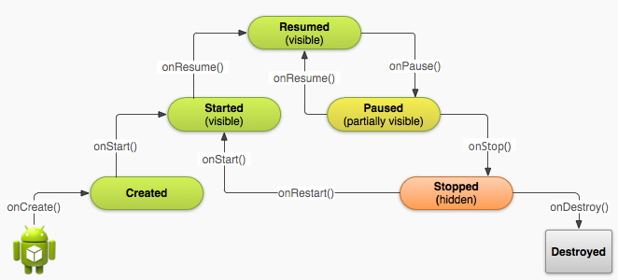
Understand the Lifecycle Callbacks
Simplified view of the Activity lifecycle
For every callback method used to take the activity a step toward the Resumed state at the top, there's a callback method that takes the activity a step down
The activity can also return to the resumed state from the Paused and Stopped state

Slide 9
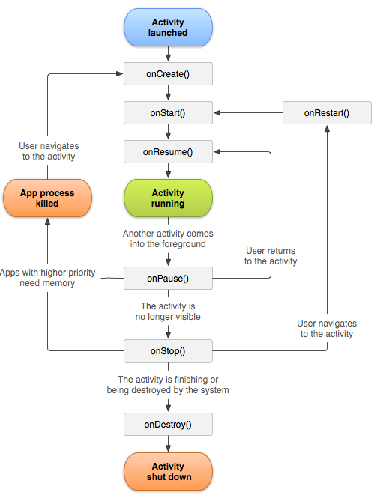

Slide 10
Understand the Lifecycle Callbacks
Implementing activity lifecycle methods properly ensures the app behaves well in several ways, including that it:
Does not crash if the user receives a phone call or switches to another app while using your app.
Does not consume valuable system resources when the user is not actively using it.
Does not lose the user's progress if they leave your app and return to it at a later time.
Does not crash or lose the user's progress when the screen rotates between landscape and portrait orientation.

Slide 11
Understand the Lifecycle Callbacks
Several situations in which an activity transitions between different states
Only three of these states can be static
The activity can exist in one of only three states for an extended period of time

Slide 12
Understand the Lifecycle Callbacks
Resumed
The activity is in the foreground and the user can interact with it
Paused
The activity is partially obscured by another activity
The paused activity does not receive user input and cannot execute any code
Stopped
The activity is completely hidden and not visible to the user
Considered to be in the background
The activity instance and all its state information such as member variables is retained, but it cannot execute any code

Slide 13
Understand the Lifecycle Callbacks
Other states (Created and Started) are transient
System moves from them to the next state by calling the next lifecycle callback method
That is, after the system calls onCreate(), it then calls onStart(), which is followed by onResume()
When the user selects the app icon from the Home screen, the system calls the onCreate() method for the Activity declared to be the "launcher" activity
This is the activity that serves as the app’s entry point
You can define which activity to use as the main activity in the Android manifest file

Slide 14
Creating a New Instance
When the program is started, the system creates a new instance of Activity by calling its onCreate() method
You must implement the onCreate() method to perform basic application startup logic that should happen only once for the entire life of the activity
onCreate() should
Define the user interface
Possibly instantiate some class-scope variables

Slide 15
Creating a New Instance
Once the onCreate() finishes execution, the system calls the onStart() and onResume() methods
Technically, the activity becomes visible to the user when onStart() is called
But onResume() follows and the activity remains in the Resumed state until something occurs to change that

Slide 16
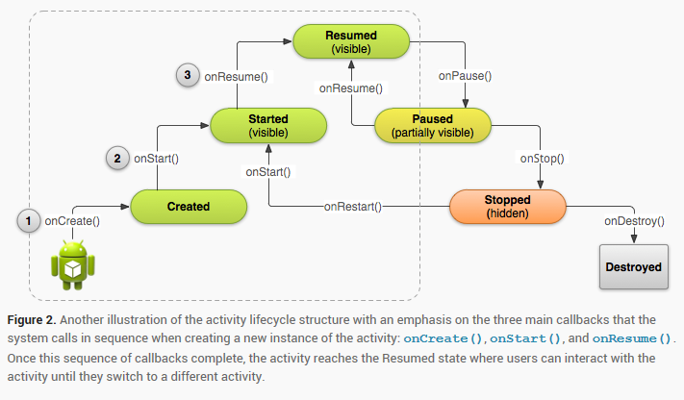
Creating a New Instance

Slide 17
Destroy an Activity
First lifecycle callback is onCreate(), its very last callback is onDestroy()
The system calls this method as the final signal that the activity instance is being completely removed from the system memory
Most apps don't need to implement this method because local class references are destroyed with the activity and your activity should perform most cleanup during onPause() and onStop()

Slide 18
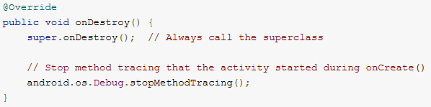
Destroy an Activity
However, if activity includes background threads or other long-running resources that could potentially leak memory if not properly closed, kill them during onDestroy()

Slide 19
Pausing and Resuming and Activity
If the foreground activity is obstructed by other visual components the activity pauses.
As long as the activity is still partially visible but currently not the activity in focus, it remains paused
If the activity is fully-obstructed and not visible, it stops

Slide 20
Pausing and Resuming an Activity
Entering the paused state, the system calls the onPause() method
Stop ongoing actions that should not continue while paused (such as a video)
Persist any information that should be permanently saved in case the user continues to leave your app
Returning to the activity from the paused state, calls the onResume() method
Note: When activity receives a call to onPause(), it may be an indication that the activity will be paused for a moment and the user may return focus or it may be the first indication that the user is leaving the activity

Slide 21
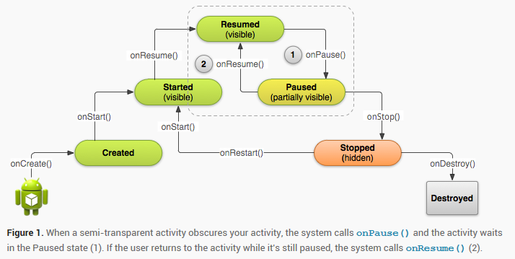
Pausing and Resuming an Activity

Slide 22
Pausing an Activity
Use the onPause() callback to:
Stop animations or other ongoing actions that could consume CPU resources
Commit unsaved changes (such as a draft email or shared preferences)
Release system resources, that may affect battery life while your activity is paused and the user does not need them (such as broadcast receivers, handles to sensors like GPS)

Slide 23
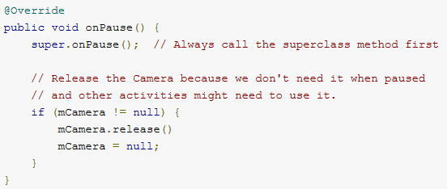
Pausing an Activity
For example, if the application uses the Camera, the onPause() method is a good place to release it

Slide 24
Pausing your Activity
Avoid performing CPU-intensive work during onPause(), such as writing to a database, because it can slow the visible transition to the next activity
Keep operations done in the onPause() method relatively simple in order to allow for a speedy transition

Slide 25
Resume your Activity
Resuming an activity from the Paused state, the system calls the onResume() method
Be aware: the system calls this method every time the activity comes into the foreground, including when it's created for the first time
As such, implement onResume() to initialize components that released during onPause() and perform any other initializations that must occur each time the activity enters the Resumed state (such as begin animations and initialize components only used while the activity has user focus)

Slide 26
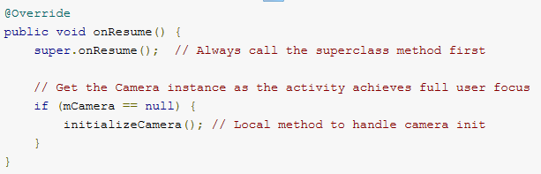
Resume your Activity
The following example of onResume() is the counterpart to the onPause() example, so it initializes the camera that's released when the activity pauses

Slide 27
Stopping & Restarting an Activity
There are a few of key scenarios in which an activity is stopped and restarted:
The user opens the Recent Apps window and switches from current app to another app. The activity in current app is stopped. If the user returns to the app from the Home screen launcher icon or the Recent Apps window, the activity restarts
The user performs an action in current app that starts a new activity. The current activity is stopped when the second activity is created. If the user then presses the Back button, the first activity is restarted.

Slide 28
Stopping & Restarting an Activity
Two lifecycle methods, onStop() and onRestart(), to specifically handle how stops and restarts
Unlike the paused state, which identifies a partial UI obstruction, the stopped state guarantees that the UI is no longer visible and the user's focus is in a separate activity (or an entirely separate app).

Slide 29
Stopping & Restarting an Activity
Note: System retains Activity instance in system memory when it is stopped so may not need to implement the onStop() and onRestart() (or even onStart()) methods at all
For most activities that are relatively simple, the activity will stop and restart just fine and you might only need to use onPause() to pause ongoing actions and disconnect from system resources

Slide 30
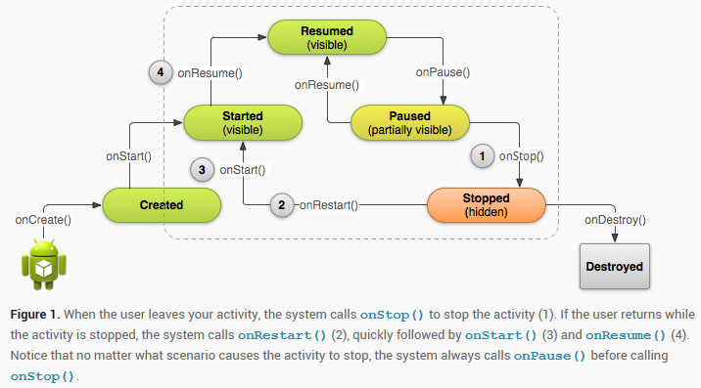
Stopping & Restarting an Activity

Slide 31
Stop your Activity
Activity receives a call to the onStop() method, when it's no longer visible and should release almost all resources that aren't needed while the user is not using it
Once activity is stopped, the system might destroy the instance if it needs to recover system memory
In extreme cases, the system might simply kill the app process without calling the activity's final onDestroy() callback, so it's important you use onStop() to release resources that might leak memory

Slide 32
Stop your Activity
Use onStop() to perform larger, more CPU intensive shut-down operations, such as writing information to a database
When activity is stopped, the Activity object is kept resident
Therefore don’t need to re-initialize components that were created during any of the callback methods leading up to the Resumed state
The system also keeps track of the current state for each View in the layout, so if the user entered text into an EditText widget, that content is retained so you don't need to save and restore it.

Slide 33
Start / Restart your Activity
When activity comes back to the foreground from the stopped state, it receives a call to onRestart()
The system also calls the onStart() method, which happens every time your activity becomes visible
Use onRestart() to perform special restoration work that might be necessary only if the activity was previously stopped, but not destroyed

Slide 34
Start / Restart your Activity
onStop() method should clean up all activity's resources, so need to re-instantiate them when the activity restarts
Also need to instantiate them when activity is created for the first time
Therefore usually use the onStart() callback method as the counterpart to the onStop() method, because the system calls onStart() both when it creates the activity and when it restarts the activity from the stopped state

Slide 35
Recreating an Activity
There are a few scenarios in which an activity is destroyed due to normal app behavior, such as when the user presses the Back button or activity calls finish()
The system may also destroy an activity if it's currently stopped and hasn't been used in a long time or to recover memory

Slide 36
Recreating an Activity
When user presses Back or the activity finishes itself, the system's concept of that Activity instance is gone forever because the behaviour indicates the activity is no longer needed
However, if the system destroys the activity due to system constraints then the system remembers that it existed so if the user navigates back to it, the system creates a new instance of the activity using a set of saved data that describes the state of the activity when it was destroyed

Slide 37
Recreating an Activity
The saved data that the system uses to restore the previous state is called the "instance state" and is a collection of key-value pairs stored in a Bundle object
Note: In order for the Android system to restore the state of the views in an activity, each view must have a unique ID, supplied by the android:id attribute

Slide 38
Recreating an Activity
Caution: activity will be destroyed and recreated each time the user rotates the screen.
When the screen changes orientation, the system destroys and recreates the foreground activity because the screen configuration has changed
Activity might need to load alternative resources (such as the layout)

Slide 39
Recreating an Activity
By default, the system uses the Bundle instance state to save information about each View object in activity layout (such as the text value entered into an EditText object)
So, if activity instance is destroyed and recreated, the state of the layout is restored to its previous state with no code required

Slide 40
Recreating an Activity
However, activity might have more state information to restore, such as variables that track the user's progress in the activity
To save additional data about the activity state, override the onSaveInstanceState() callback method
The system calls this method when the user is leaving your activity and passes it the Bundle object that will be saved in the event that your activity is destroyed unexpectedly
If the system must recreate the activity instance later, it passes the same Bundle object to both the onRestoreInstanceState() and onCreate()methods

Slide 41
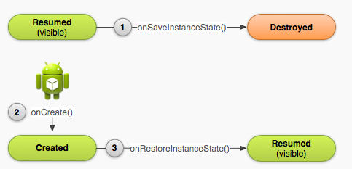
Recreating an Activity
As the system begins to stop an activity, it calls onSaveInstanceState() (1) so specify additional state data to save in case the Activity instance must be recreated. If the activity is destroyed and the same instance must be recreated, the system passes the state data defined at (1) to both the onCreate() method (2) and the onRestoreInstanceState() method (3).

Slide 42
Saving Activity State
As activity begins to stop, the system calls onSaveInstanceState() so activity can save state information with a collection of key-value pairs.
Default implementation of this method saves information about the state of the activity's view hierarchy, such as the text in an EditText widget or the scroll position of a ListView
To save additional state information, implement onSaveInstanceState() and add key-value pairs to the Bundle object. For example:

Slide 43
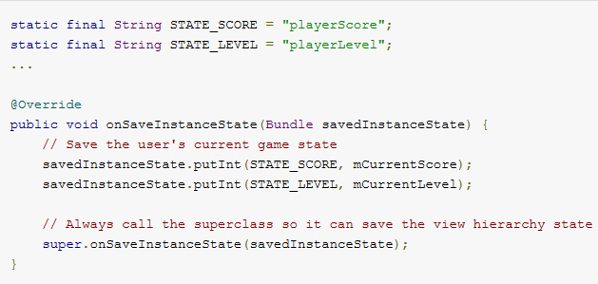
Saving Activity State
Notes:
Caution: Always call the superclass implementation of onSaveInstanceState() so the default implementation can save the state of the view hierarchy.

Slide 44
Restoring Activity State
Recover your saved state from the Bundle that the system passes your activity
Both the onCreate() and onRestoreInstanceState() callback methods receive the same Bundle that contains the instance state information
Because the onCreate() method is called whether the system is creating a new instance of your activity or recreating a previous one, must check whether the state Bundle is null before you attempt to read it
For example, here's how to restore some state data in onCreate():

Slide 45
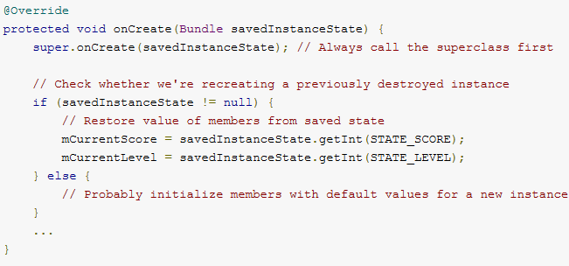
Restoring Activity State

Slide 46
Restoring Activity State
Instead of restoring the state during onCreate() may choose to implement onRestoreInstanceState(), which the system calls after the onStart() method
The system calls onRestoreInstanceState() only if there is a saved state to restore, so do not need to check whether the Bundle is null:

Slide 47
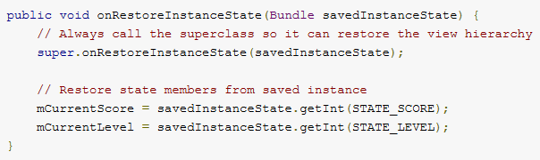
Restoring Activity State
Notes:
Caution: Always call the superclass implementation of onRestoreInstanceState() so the default implementation can restore the state of the view hierarchy.

